Slide 1
ASA: A Simulation Environment for Evaluating Military Operational Scenarios
Joao P. A. Dantas,1st Lt
Decision Support Systems Subdivision
Institute for Advanced Studies
Brazilian Air Force

Slide 2
AGENDA
Big Picture
Related Work
Definition
Features
Architecture
Applications
Summary

Slide 3
BIG PICTURE
Commanders: experience and intuition to make decisions
The modern battlefield scenarios brought new challenges
New technologies: missiles, drones, RWR, air defense systems
Simulation and Data Analysis to support the decision-making process in the Theater of Operations
Requiring more integrated and flexible solutions: technical and organizational aspects
Establish strategies, parameters, and command decisions to the aerospace context for defense purposes

Slide 4
RELATED WORK
[Clive et al, CSC 2015] The Advanced Framework for Simulation, Integration and Modeling (AFSIM)
2003-2013 Boeing
$50M investment, restricted to a few US partners
Common modeling framework
AFRL has licensed it to over 275 government, industry, and academic organizations, and provided training to over 1200 users
[Hodson et al, CSC 2018] Mixed Reality Simulation Platform (MIXR)
OpenEaagles
Opensource
Construction of virtual (human-in-the-loop) and constructive simulation applications
Modern C++ object-oriented software design

Slide 5
DEFINITION
[2018] Institute for Advanced Studies
The Aerospace Simulation Environment or Ambiente de Simulação Aeroespacial -- ASA in Portuguese
Computational solution that enables the modeling and simulation of operational scenarios
Flexible solution that may be tailored to the user needs
Requirements: not attended by commercial off-the-shelf simulation software
Use simulation to make decisions
Support Brazilian Air Force strategic planning
Meet operational analysis needs
Development and evaluation of new technologies to enhance military research

Slide 6
FEATURES
ASA: extension of the MIXR’s possibilities
We created a manager application with a distributed architecture for managing multiple simulation machines
The capability of loading models at simulation runtime
Batch mode execution to perform multiple executions using different initial parameters
A visualization tool that suits the Brazilian Air Force technical requirements
Data analysis platform for post-processing simulation data

Slide 7
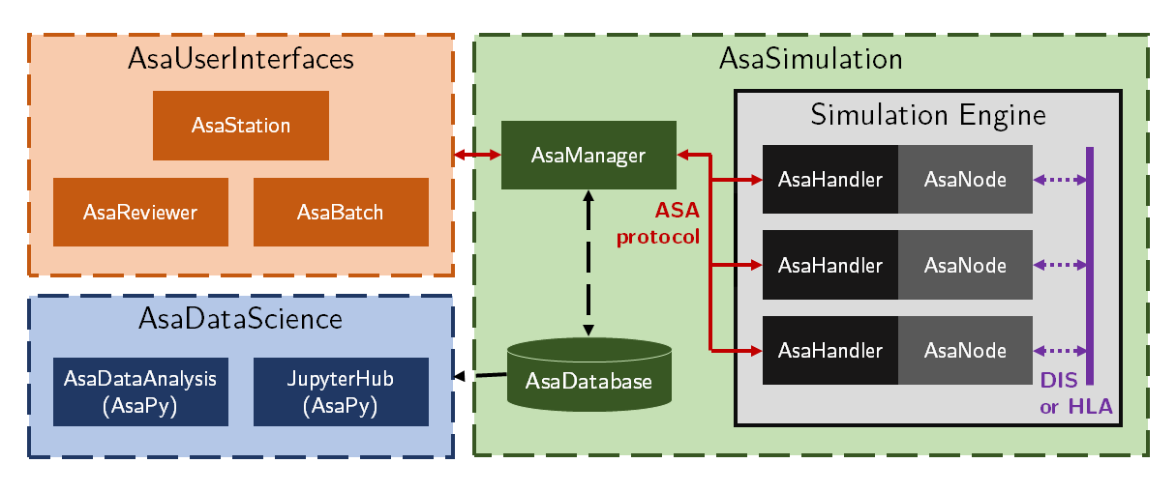
ARCHITECTURE

Slide 8
ARCHITECTURE: AsaSimulation

Slide 9
ARCHITECTURE: AsaSimulation
AsaDatabase
Keeps agent metadata, simulation scenarios, execution data, and analysis results
AsaManager
Responsible for coordinating and synchronizing the processes in a distributed manner.
Controlling the simulation processing nodes
Receives control commands (play, pause, resume, and stop) and transmits them to the simulation engine
CRUD methods: responsible for accessing the AsaDatabase and updating it
Tasks imperceptible for the user:
Loading extensions metadata
Converting the JSON scenario specification to a compatible format (MIXR initialization scheme)
Interpreting commands to control the execution progress on the simulation machine
Changing orders in agents’ behaviors during real-time simulation

Slide 10
ARCHITECTURE: AsaSimulation
AsaNode
The simulation engine: process the simulation itself
Estimates how the scenario will evolve, considering the models incorporated in each agent present in the simulation
Executable file compiled from the MIXR’s code and features developed by the ASA team:
Dynamically loading extensions
Controlling the execution of the simulation (pause, resume, stop, execution speed, etc.)
Run on the same machine as the AsaManager or in a clustered computing environment (batch execution)
AsaHandler
Make the bridge between AsaNode and AsaManager
Informes AsaManager which computers on a network are available to execute simulations
Receives the properly formatted specifications from AsaManager and runs an instance of AsaNode dedicated to processing them
Transmits simulation commands based on the orders received from AsaManager, obtained from the user interface

Slide 11
ARCHITECTURE: AsaUserInterfaces

Slide 12
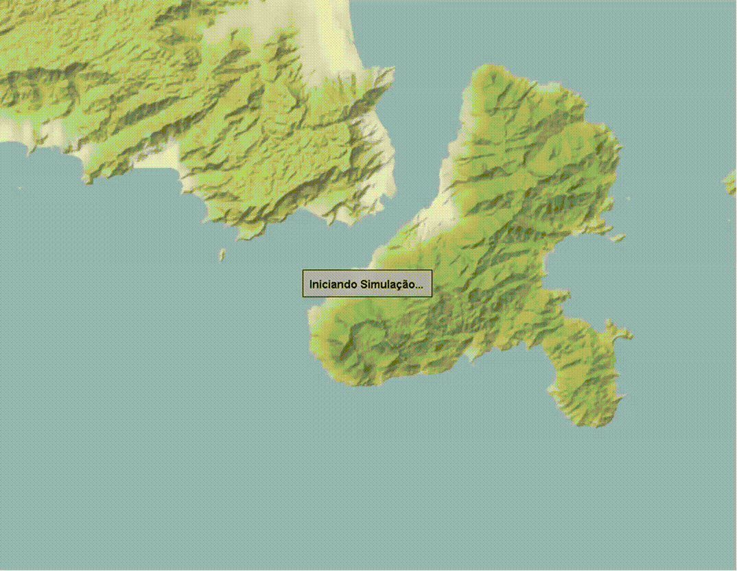
ARCHITECTURE: AsaUserInterfaces
AsaStation
Graphical User Interface
AEROGRAF [Petersen et al, 2008]
Create a scenario: military symbols, geometric drawings, aeronautical charts, and digital terrain models
Visualize how a scenario will evolve
Create, delete, or modify simulations
Change the simulation components, agents or the execution view
AsaReviewer
Revisualize simulations from the AsaDatabase
Support the decision-maker

Slide 13
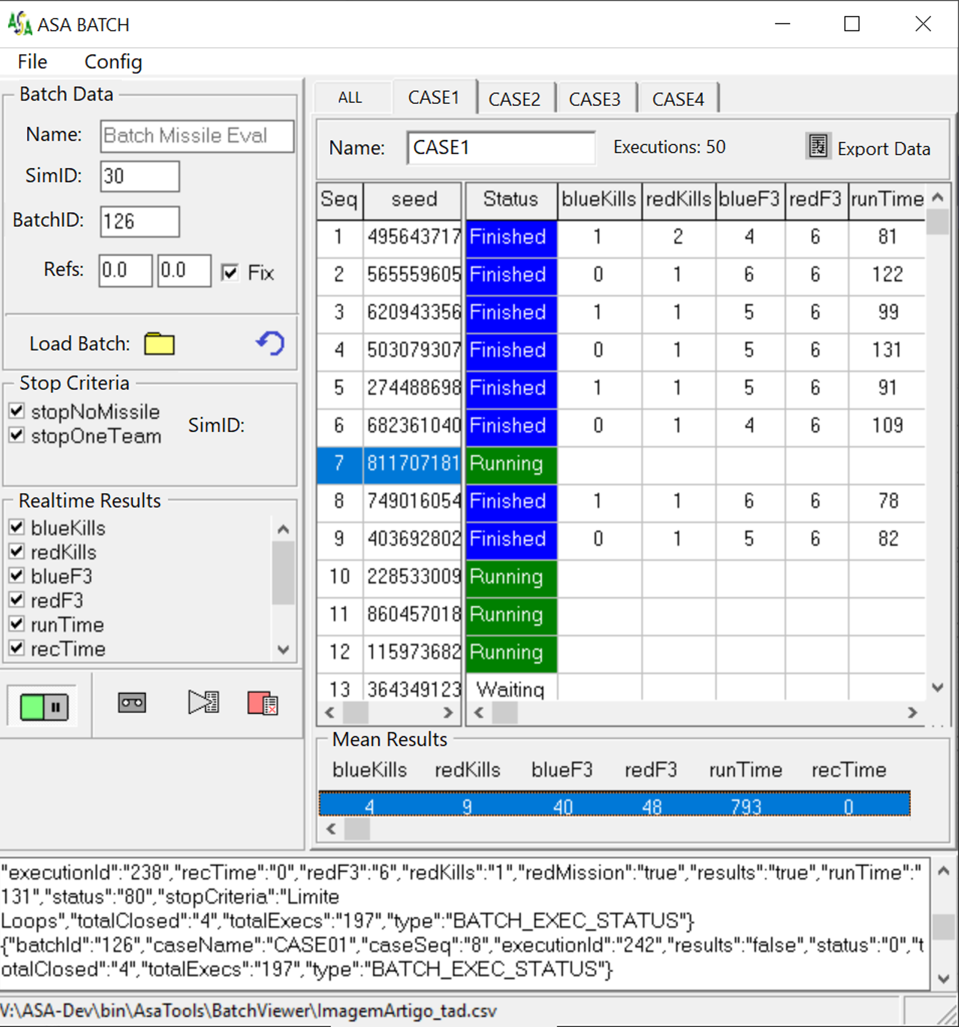
ARCHITECTURE: AsaUserInterfaces
AsaBatch
Run multiple simulations at the same time
Analyze scenarios with stochastic factors: change the initialization parameters (seed)
Starting positions of each component
Weapon performance factors
Agents’ Behaviors
Check preliminary results in real-time

Slide 14
ARCHITECTURE: AsaDataScience

Slide 15
ARCHITECTURE: AsaDataScience
Jupyter Hub
Cloud-computational environment that includes high-performance hardware
Interactive programming environment to optimize the batch execution of simulations and data analysis
AsaPy
Python analysis library
4 packages

Slide 16
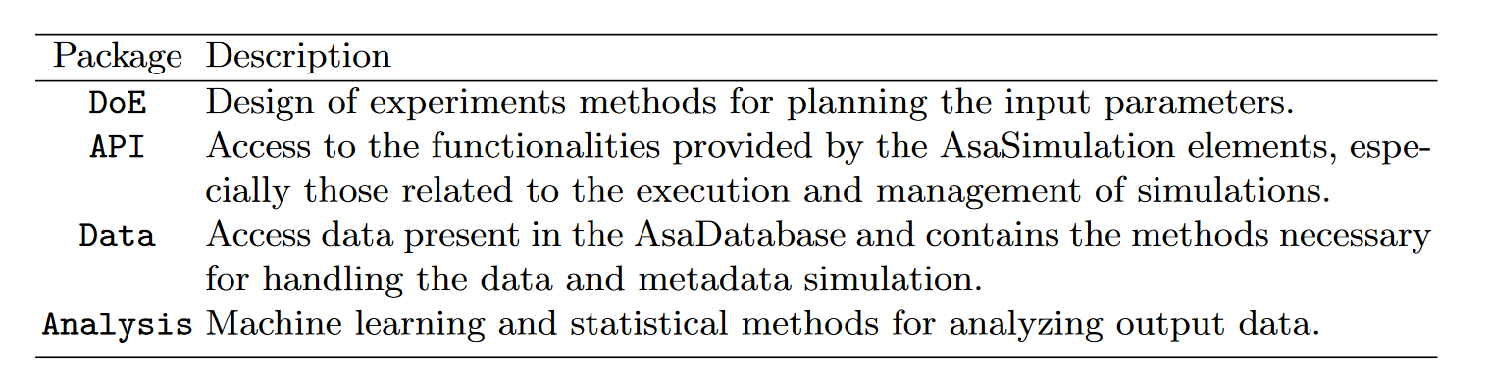
ARCHITECTURE: AsaDataScience

Slide 17
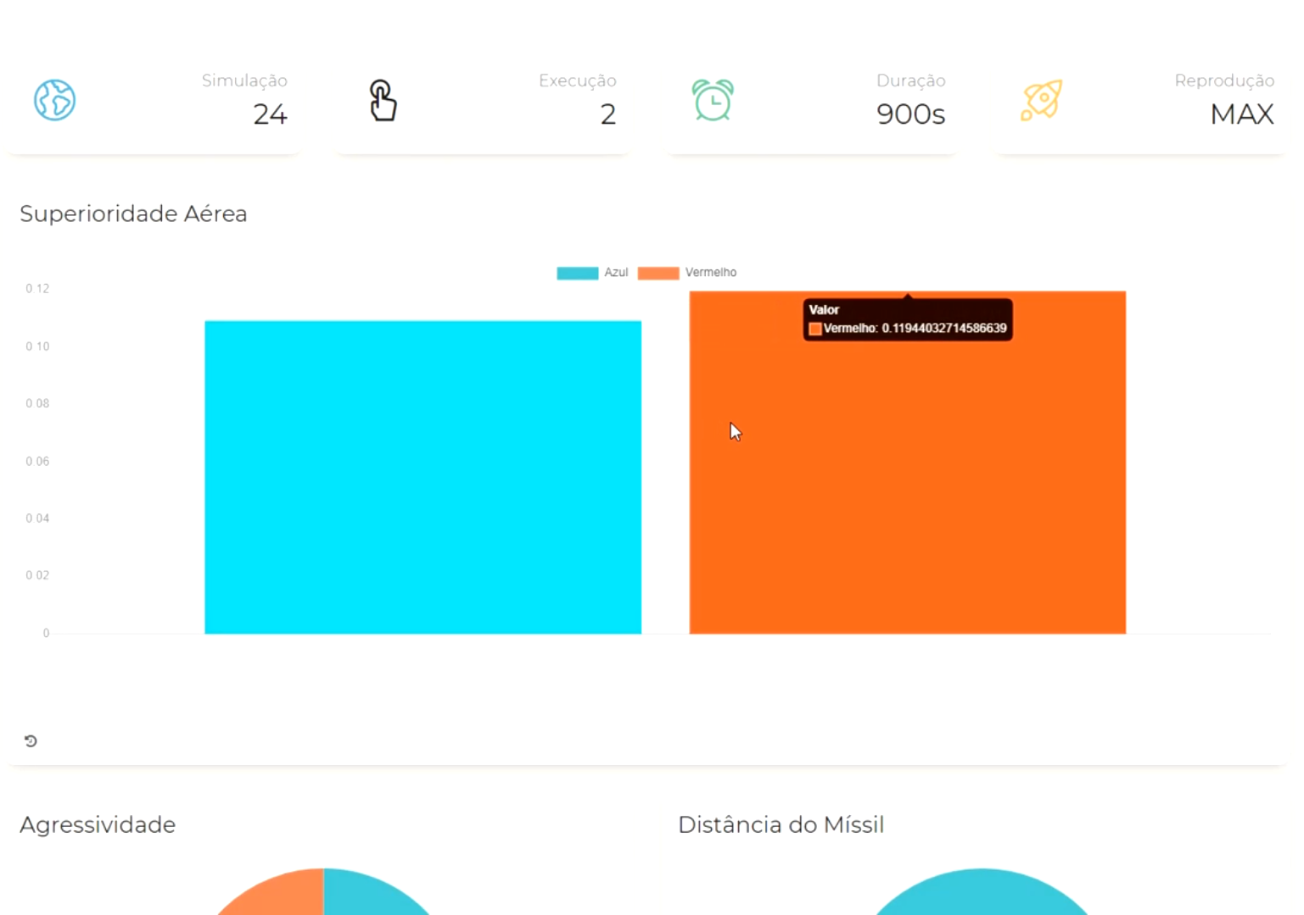
ARCHITECTURE: AsaDataScience
Web Dashboard
Visualize indices and metrics
Agents’ Measure of performance
Cost of operation
How many missiles were launched
How many aircraft were destroyed

Slide 18
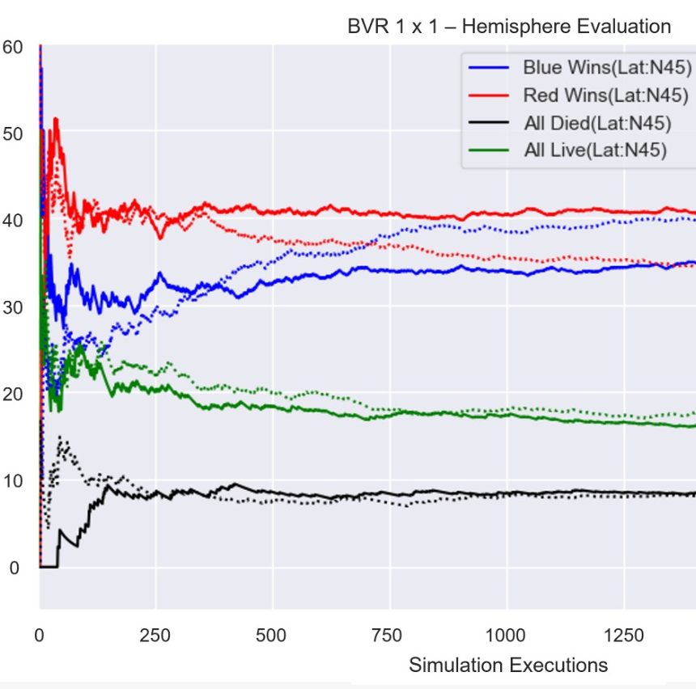
APPLICATIONS
[Kuroswiski, 2020] Agent-Based Modeling and Simulation as a Support Tool for Air Defense Capabilities Assessment
Master´s Thesis -- Aeronautics Institute of Technology (ITA)
The author analyzed the feasibility of using Agent-based Modeling and Simulation (ABMS) to assess air defense capabilities in the context of strategic planning, presenting a case study based on simulations of BVR air combat scenarios at the engagement level

Slide 19
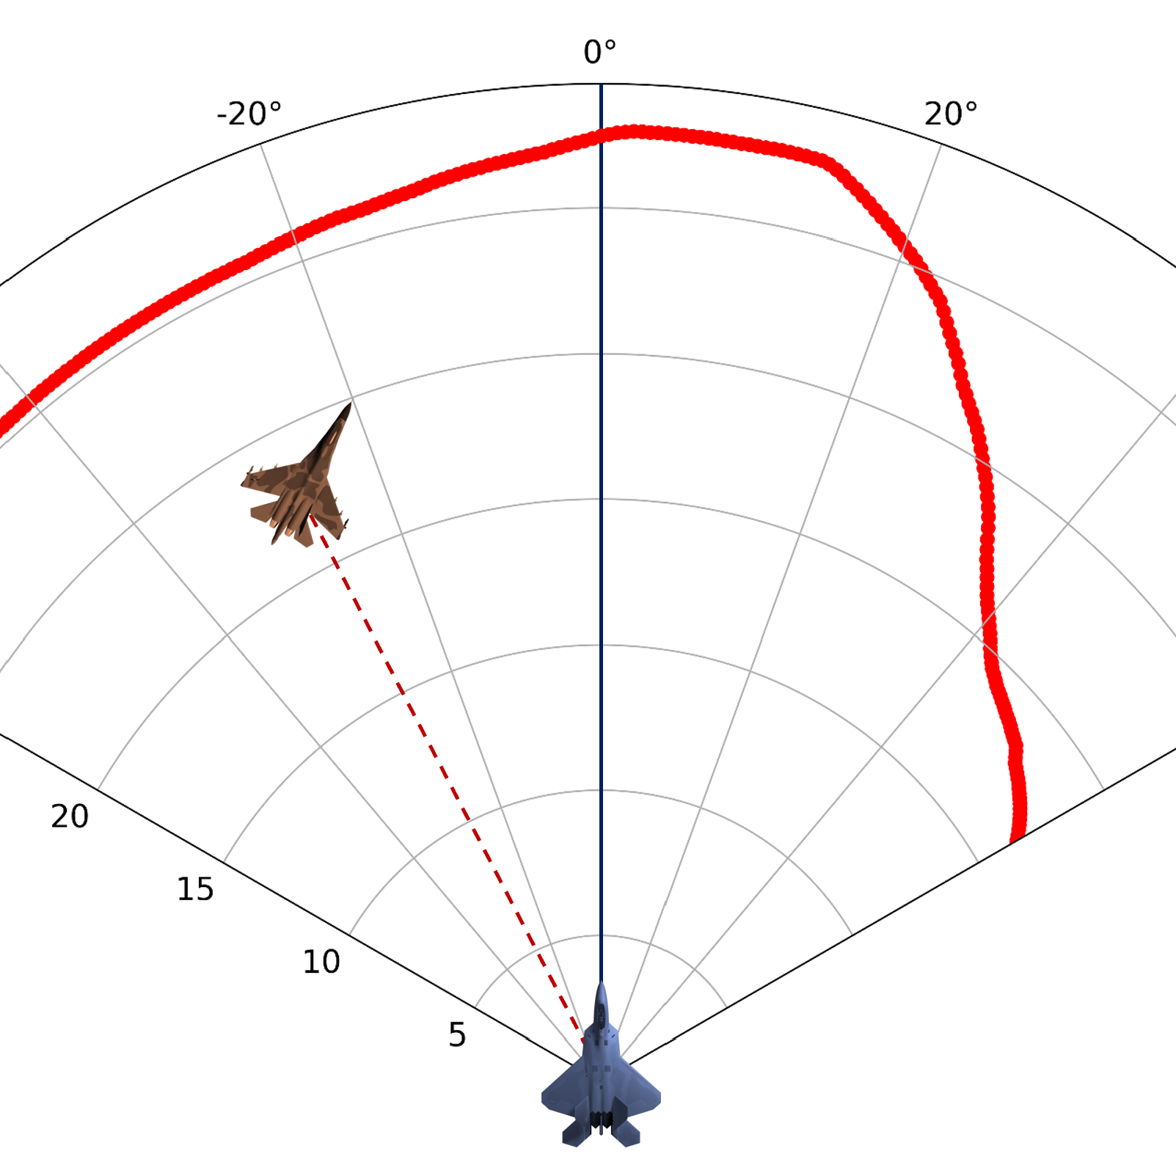
APPLICATIONS
[Dantas et al, 2021] Weapon Engagement Zone Maximum Launch Range Estimation Using a Deep Neural Network
Brazilian Conference on Intelligent Systems
A Deep Neural Network estimates the Weapon Engagement Zone maximum launch range, allowing pilots to identify the airspace in which the missile has the highest probability of success in hitting a target

Slide 20
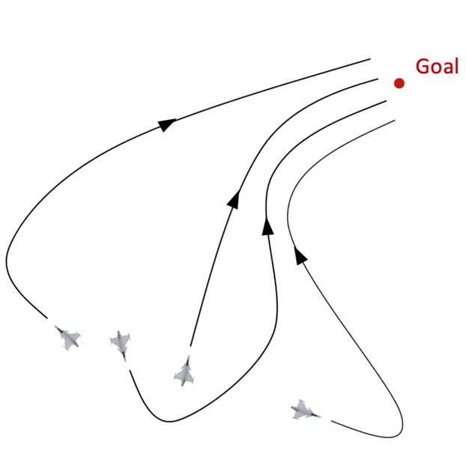
APPLICATIONS
[Costa et al, 2021] Formation control method based on artificial potential fields for aircraft flight simulation
SIMULATION SAGE
Use of both artificial potential fields and simulation optimization to achieve more robust results for simulated military aircraft to fly in formation, using a large set of scenarios for the optimization process, which evaluates its objective function through the simulations

Slide 21
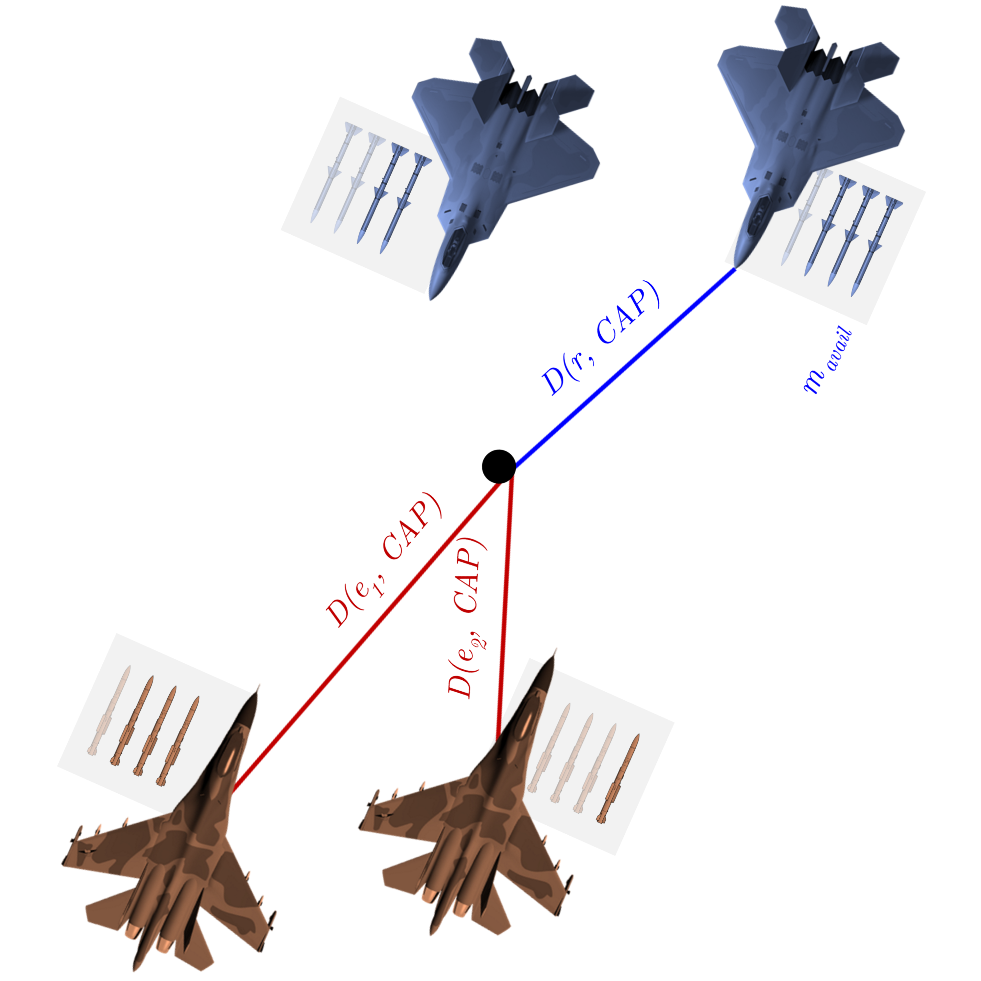
APPLICATIONS
[Dantas et al, 2021] Engagement decision support for beyond visual range air combat
Latin American Robotics Symposium
This work proposes an engagement decision support tool for BVR air combat, using a supervised learning model based on decision trees to measure the quality of a new engagement, which is the moment the pilot engages a target assuming an offensive stance and executing corresponding maneuvers.

Slide 22
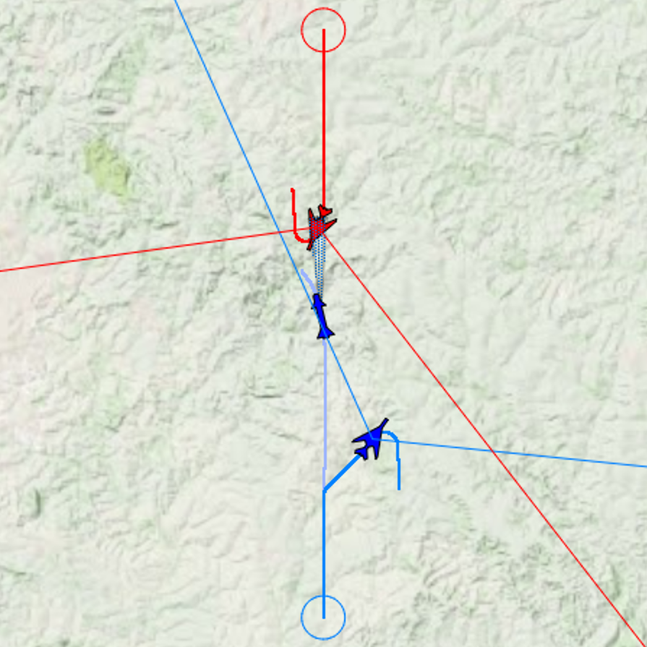
APPLICATIONS
[Dantas et al, 2022] Machine Learning to Improve Situational Awareness in Beyond Visual Range Air Combat
IEEE Latin America Transactions
The authors designed a multilayer perceptron neural network using data from constructive simulations to be employed in an embedded device to enhance the pilot's situational awareness in the in-flight decision-making process

Slide 23
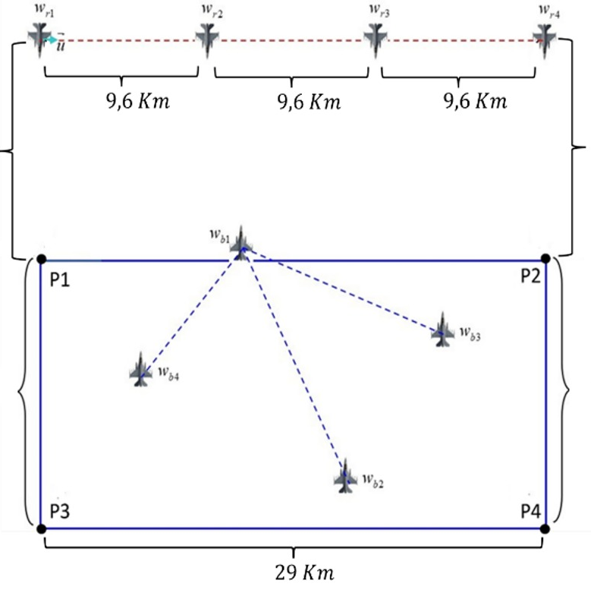
APPLICATIONS
[De Lima Filho et al, 2022] Optimization of Unmanned Air Vehicle Tactical Formation in War Games
IEEE Access
The authors integrated the ASA infrastructure into an external optimization framework to apply six different metaheuristics to optimize Unmanned Aircraft Vehicles' tactical formations, considering enemy variables such as firing distance and initial position in a BVR air combat scenario

Slide 24
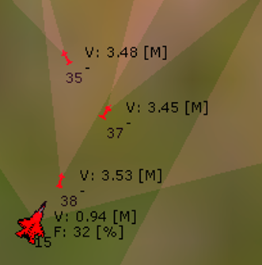
APPLICATIONS
[Dantas et al, 2022] Supervised Machine Learning for Effective Missile Launch Based on Beyond Visual Range Air Combat Simulations
Winter Simulation Conference [Accepted!]
This work compares supervised machine learning methods using reliable data from constructive simulations to estimate the most effective moment for launching missiles during air combat, using resampling techniques to improve the predictive model

Slide 25
SUMMARY
High-level overview of the ASA simulation framework
ASA: Primary goal of evaluating military operational scenarios
Distributed Architecture
Some works using ASA in the air combat context
For future work
AFSIM idea: release part of the source code with the general architecture to encourage the development of different applications in the same simulation platform
ASA will operate as a simulation-as-a-service tool to attend to diverse simulation demands in the defense and aerospace context

Slide 26
ACKNOWLEDGMENTS
Finep (Reference nº 2824/20)

Slide 27
CONTACT
E-mail: dantasjpad@fab.mil.br
Website: www.joaopadantas.com

